Slide 1

Customer Lifetime Value Prediction
AML 2203 Advanced Python AI and ML Tools

Slide 2
Team
First name | Last Name | Student number
Amrita Kaur | Badhan | C0928455
Jaldhi | Shah | C0924359
Mohamed | Gaafar | C0905127
Mukul | Sharma | C0926138

Slide 3

Problem Definition

Slide 4
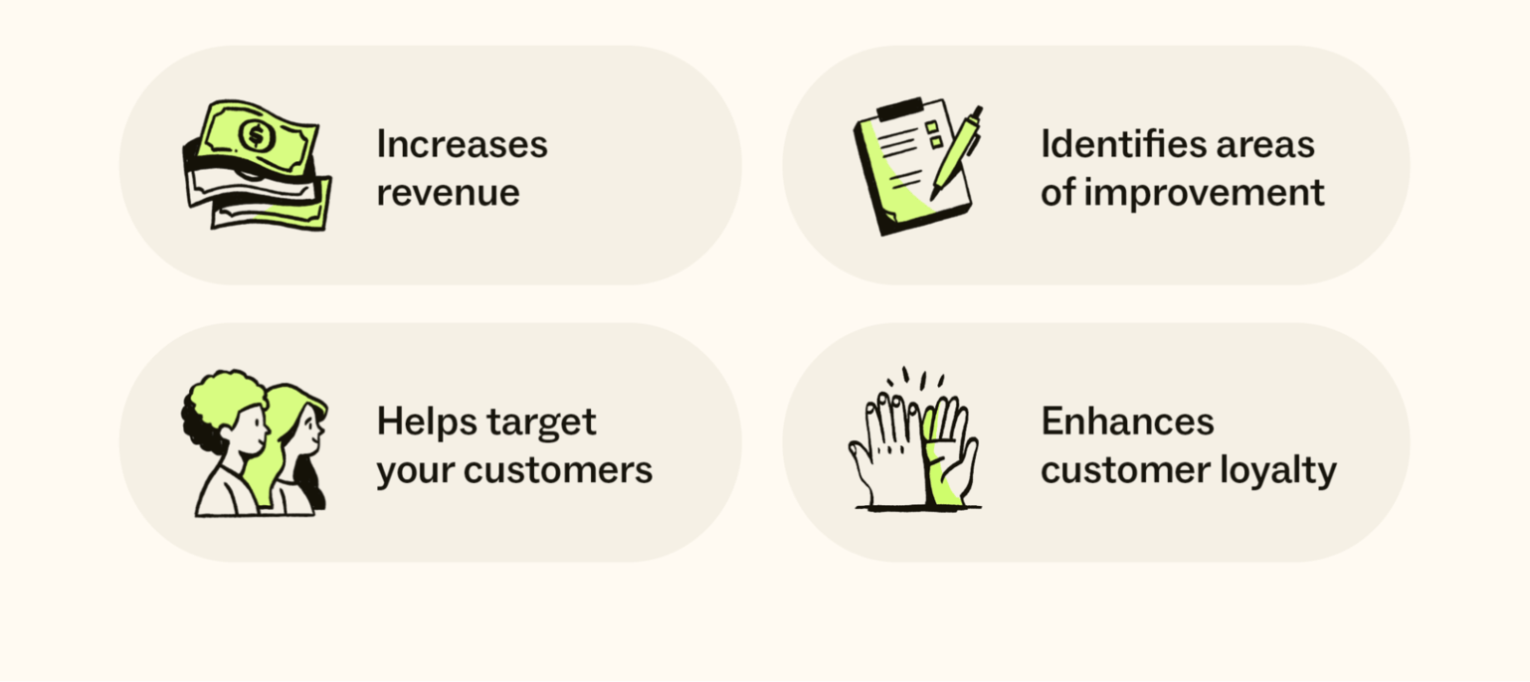
Benefits and Use Cases

Slide 5
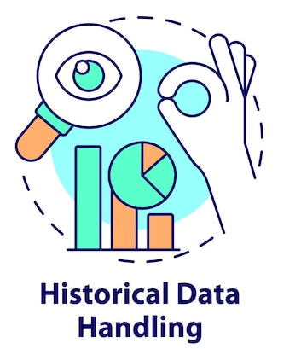


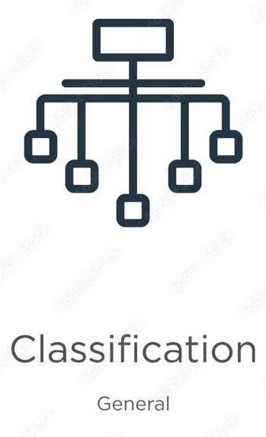
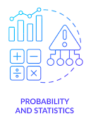
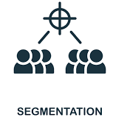
Modeling Methods

Slide 6





About Our Data

Slide 7
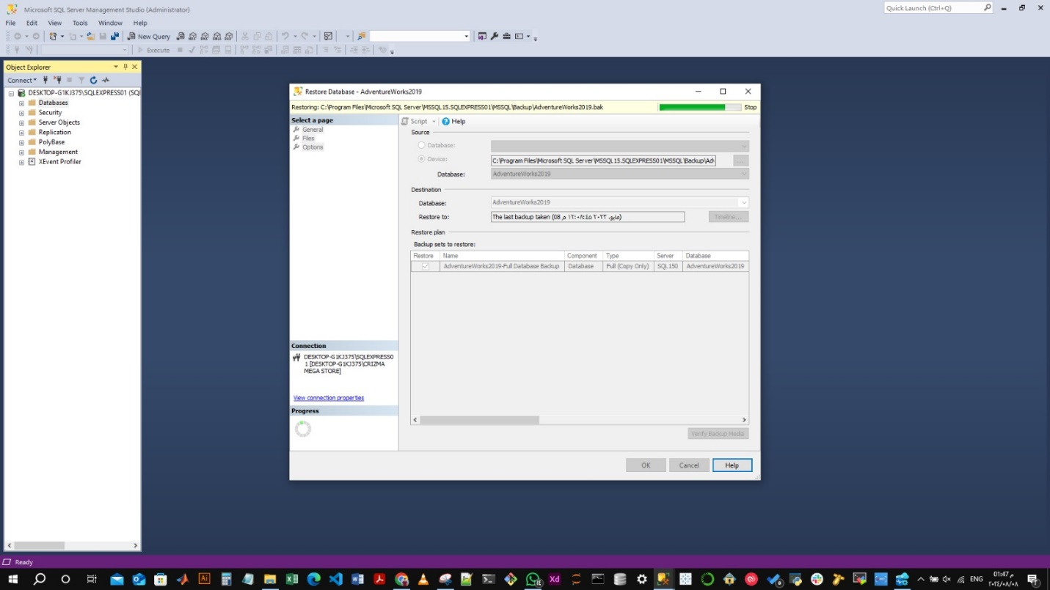
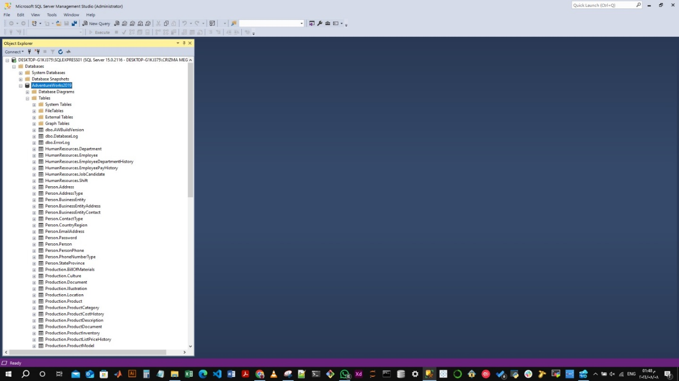

Data Accusation

Slide 8
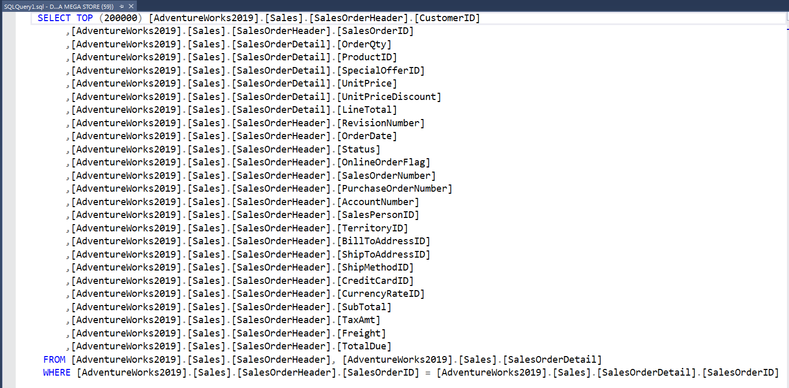
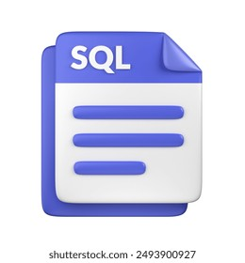
Data Accusation

Slide 9
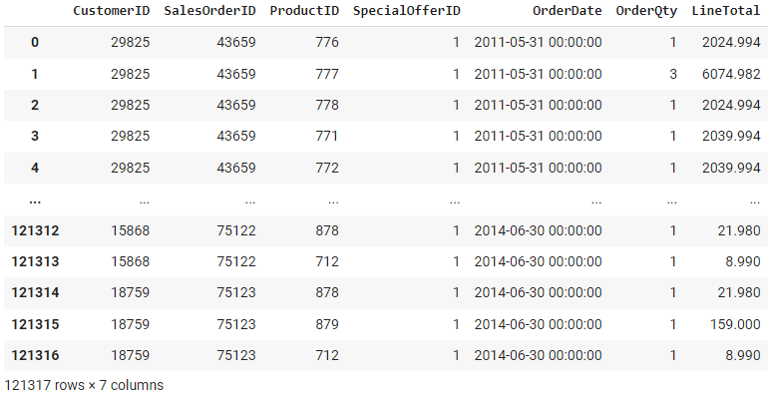
About Our Data

Slide 10
Data Pre-Processing

Slide 11
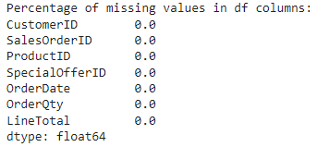
Data Cleaning

Slide 12
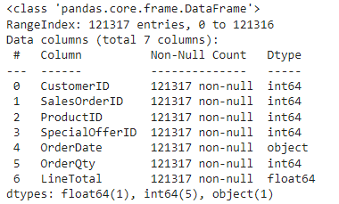
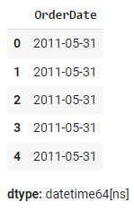
Data transforming

Slide 13
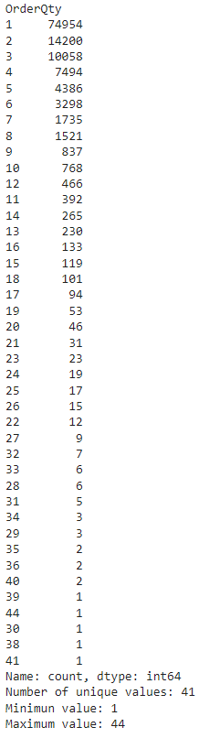
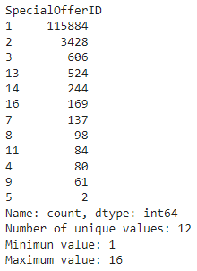
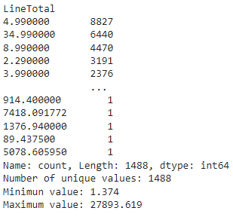
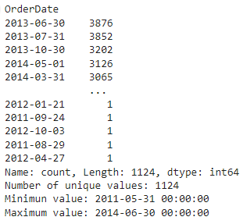
Data Integrity

Slide 14
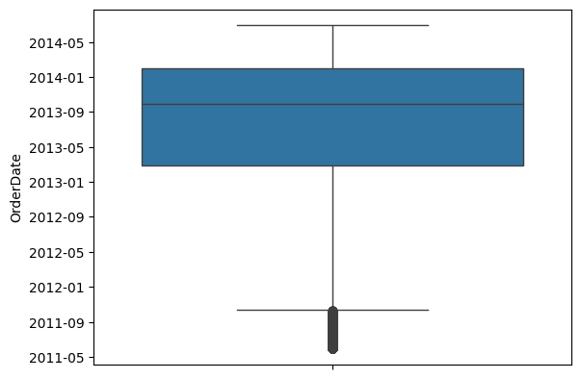
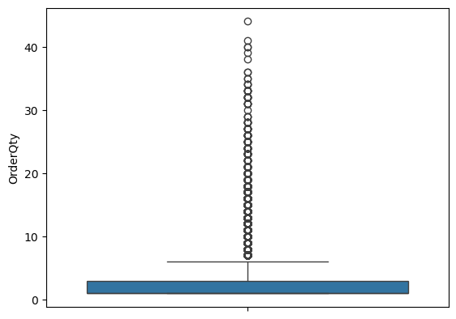
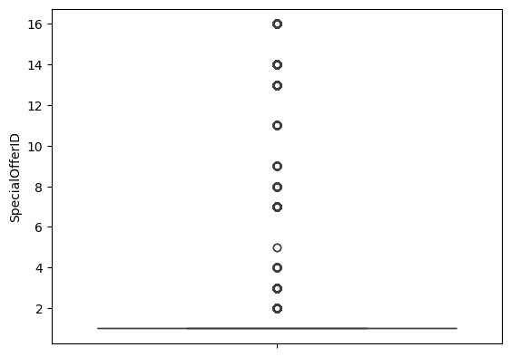
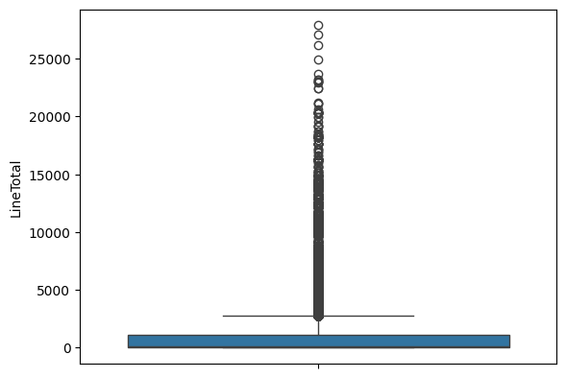
Outliers Detection

Slide 15
Data Analysis

Slide 16
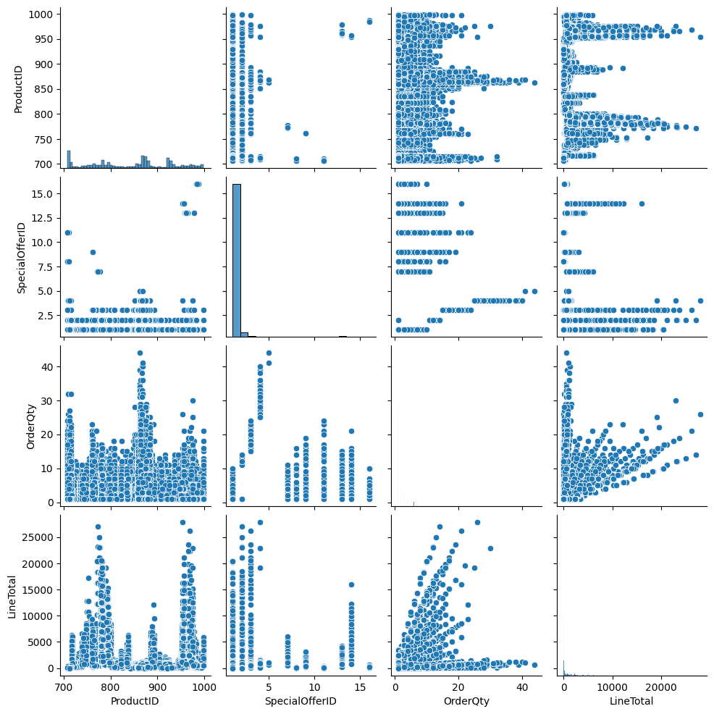
Correlation
Analysis:
Pair plot
(Scatter plot)

Slide 17
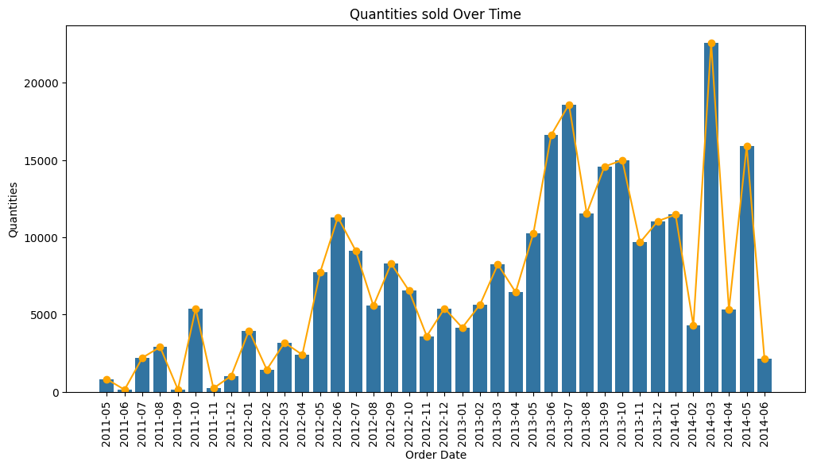
EDA
What are the Sales Trends over Time?

Slide 18
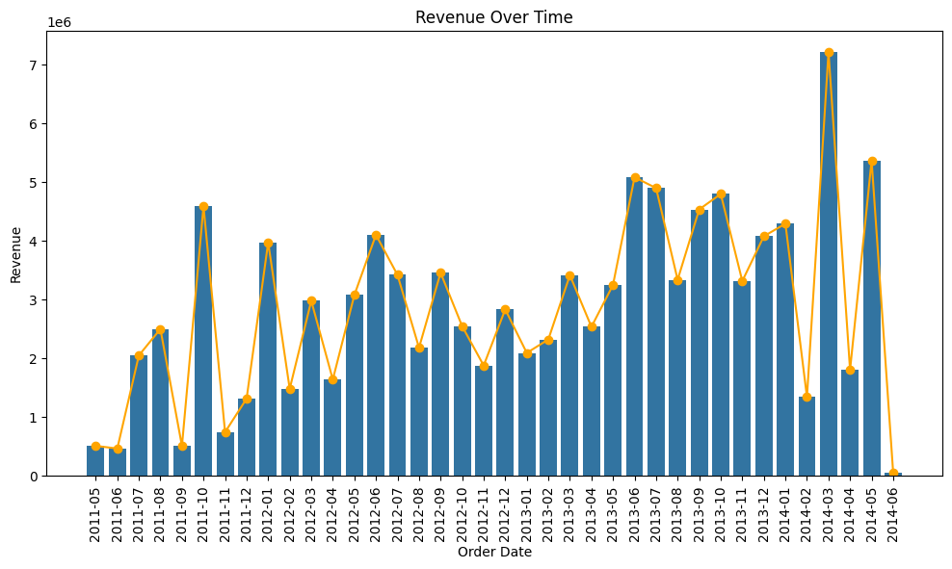
EDA
What are the Sales Trends over Time?

Slide 19
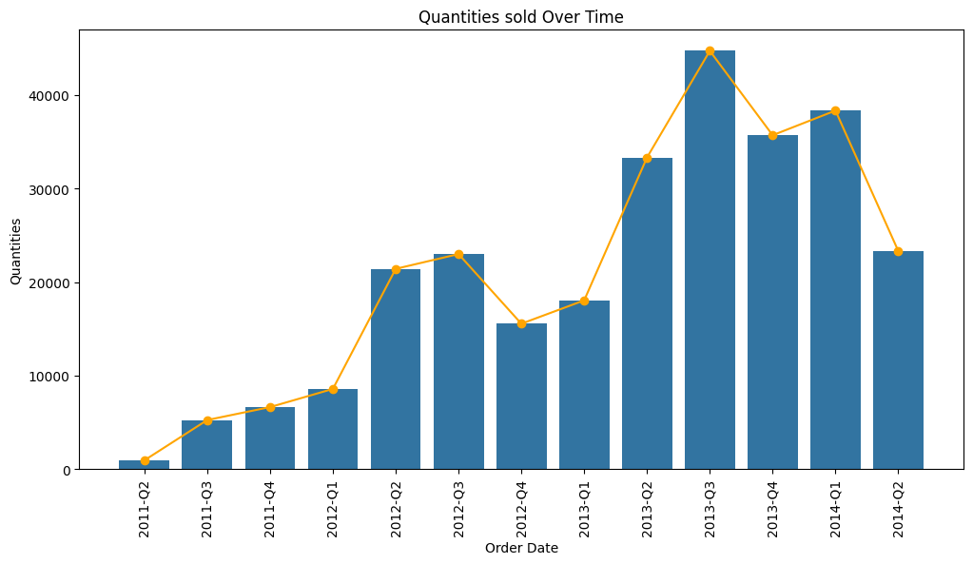
EDA
What are the Sales Trends over Time?

Slide 20
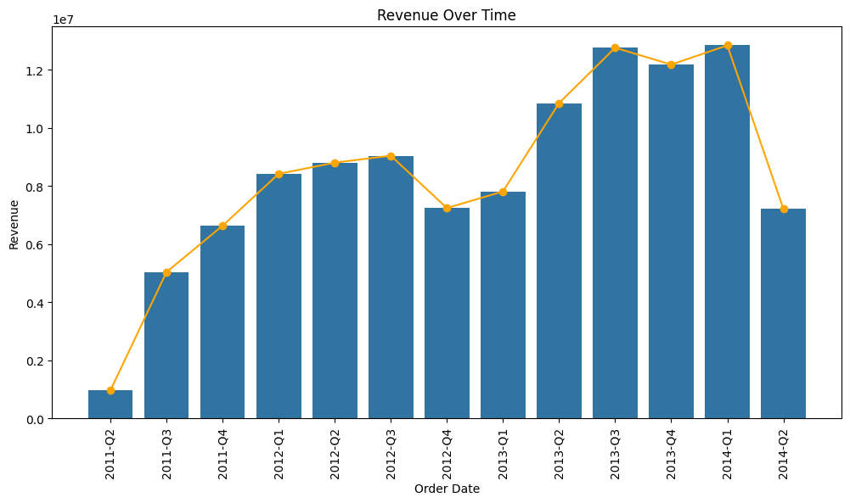
EDA
What are the Sales Trends over Time?

Slide 21
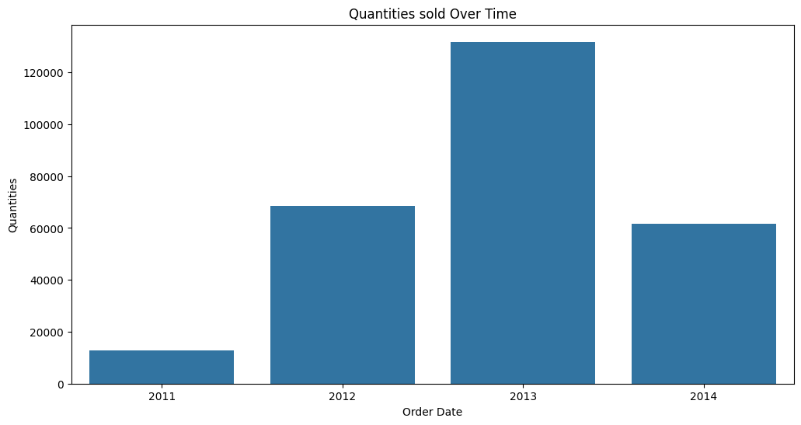
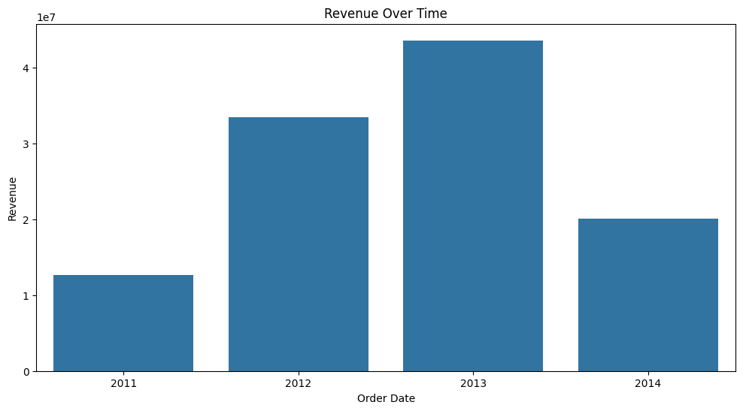
EDA
What are the Sales Trends over Time?

Slide 22
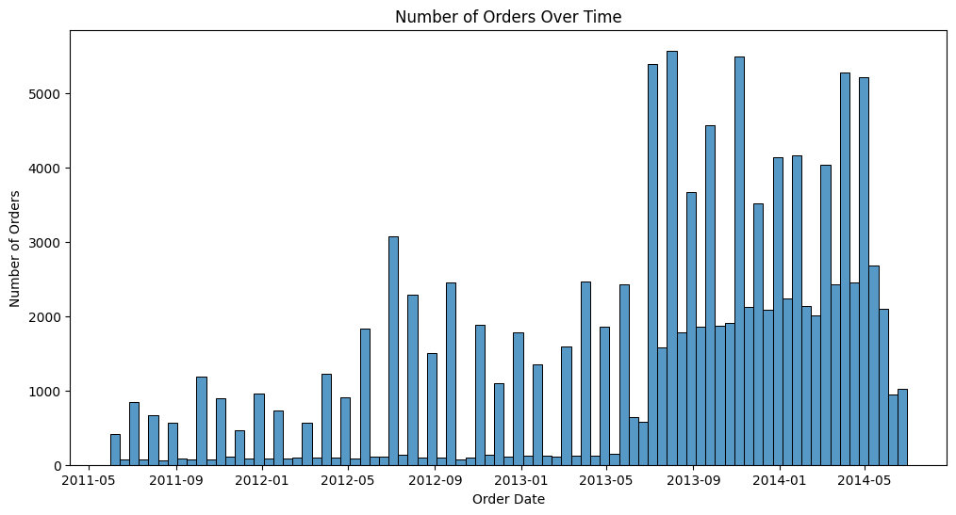
EDA
What are the number of order over time?

Slide 23
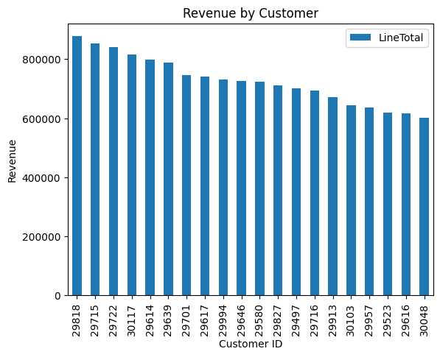
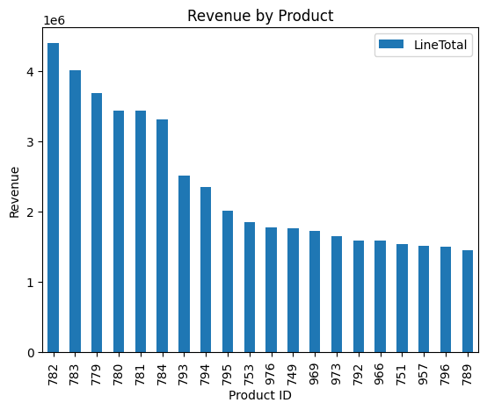
EDA
Top customers and products?

Slide 24
Data Processing

Slide 25





Outliers Trimming

Slide 26
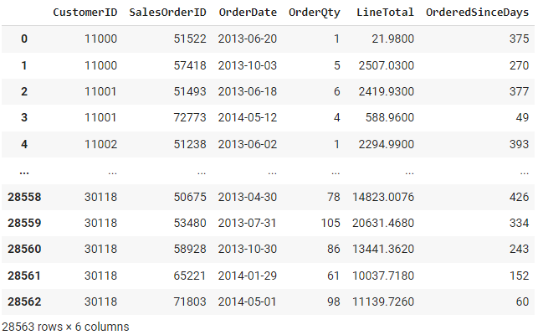
Features Engineering

Slide 27
Features Engineering

Slide 28
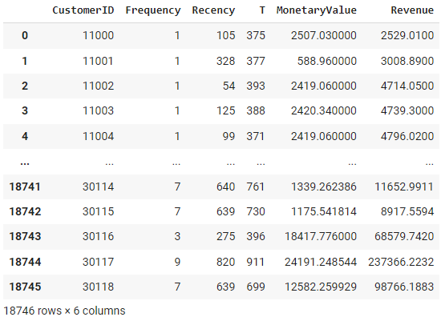
Metrics Calculation
Frequency — the number of repeat purchases (more than 1 purchases)
Recency — the time between the first and the last transaction
T — the time between the first purchase and the end of the transaction period (last date of the time frame considered for the analysis)
Monetary Value — it is the mean of a given customers sales value

Slide 29
Data Modeling

Slide 30
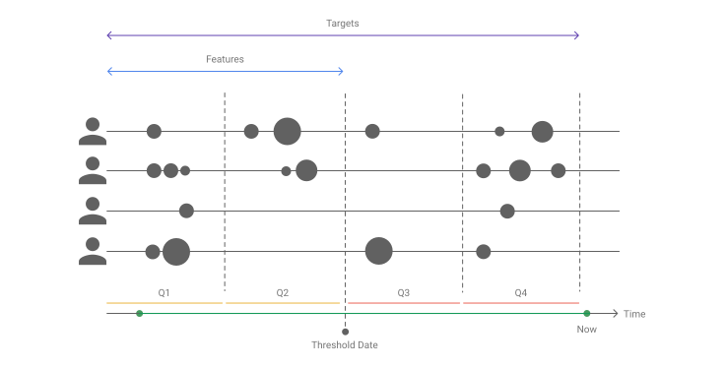
Data Preparation

Slide 31
Method 1: [Benchmark] Historical CLV
Calculate AVP = Total Revenue/ Number of Purchases
Calculate APFR = Number of Purchases/ Number of Unique Periods
Calculate CV = APV * APFR
Calculate ACL = Last Purchase - First Purchase (in years)
Calculate CLV = CV * ACL
Calculate Adjusted_CLV = CLV* Average gross margin
Calculate Predectied_CLV for next 6 months = CLV * (0.5 / Period in years)
Calculate Adjusted_Predicted_CLV = Predectied_CLV* Average gross margin

Slide 32
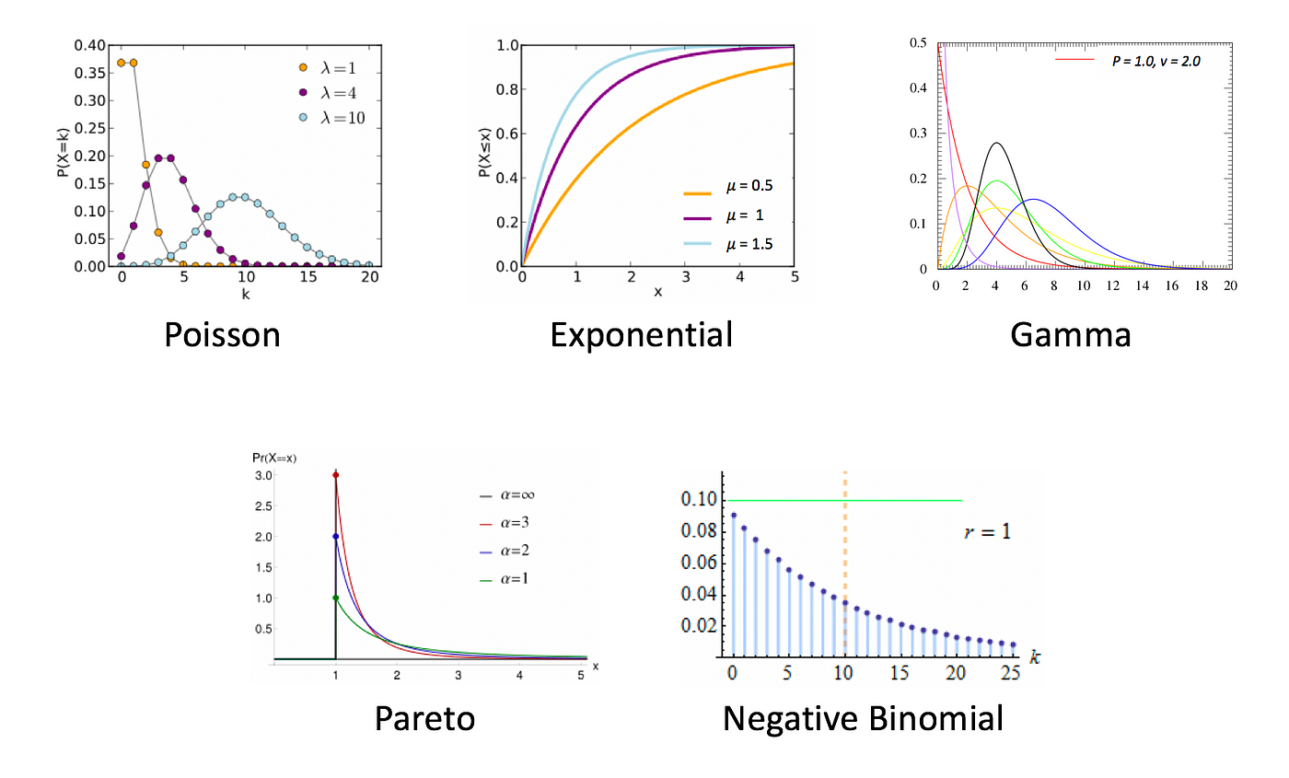
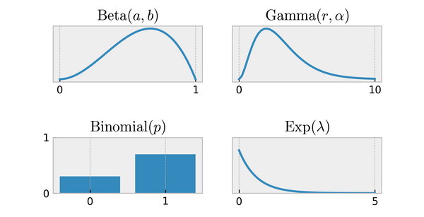
Method 2: Probabilistic BG/NBD

Slide 33
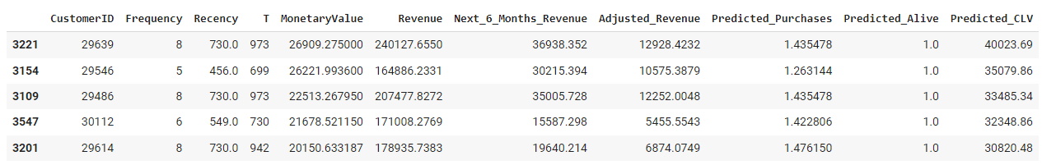
Method 2: Probabilistic BG/NBD

Slide 34
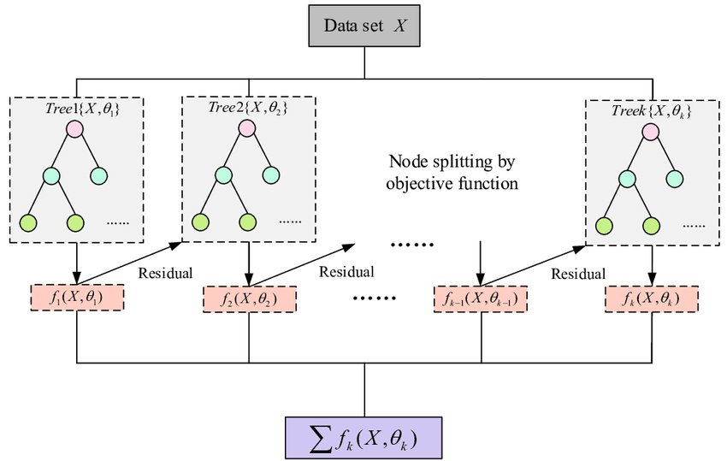
Method 3: Machine Learning Regression

Slide 35
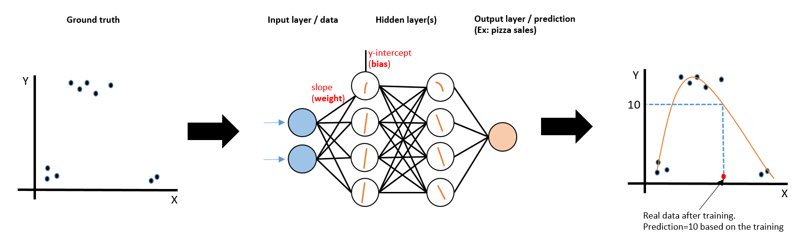
Method 4: Deep Learning Linear

Slide 36
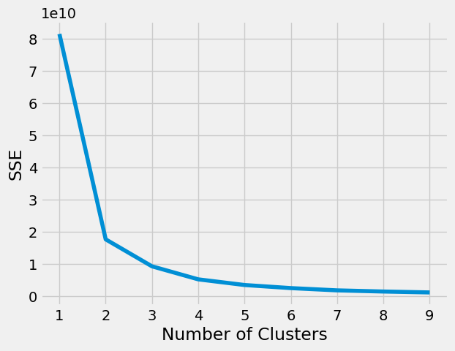
Method 5: Machine Learning Segmentation and Classification

Slide 37
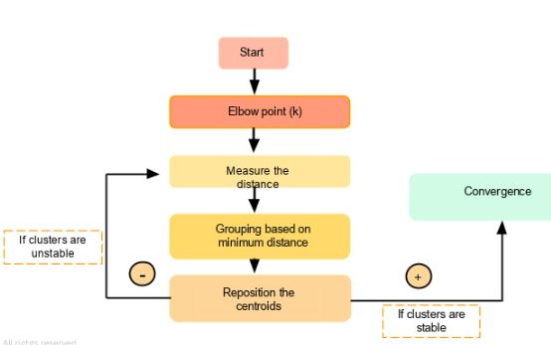
Method 5: Machine Learning Segmentation and Classification

Slide 38
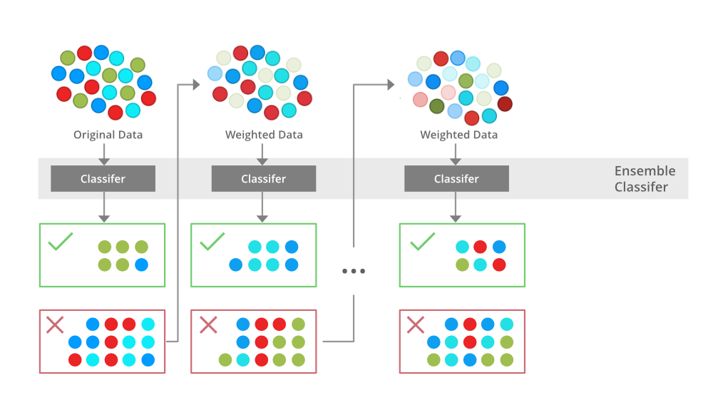
Method 5: Machine Learning Segmentation and Classification

Slide 39
Models Evaluation

Slide 40
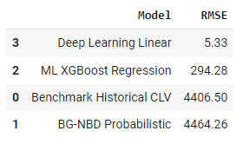
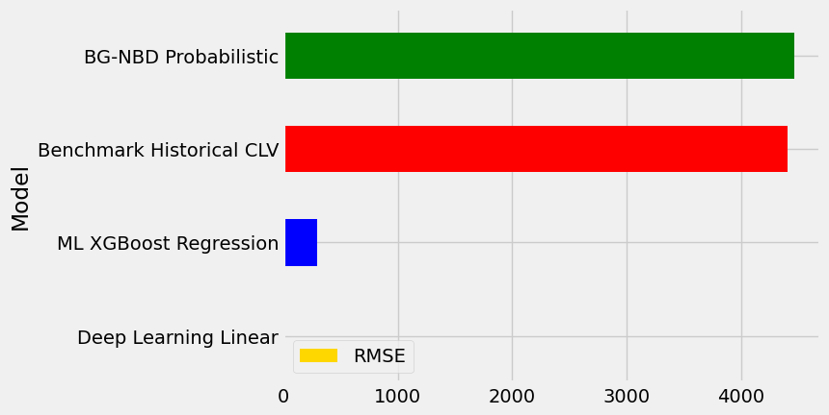
Regression Models

Slide 41
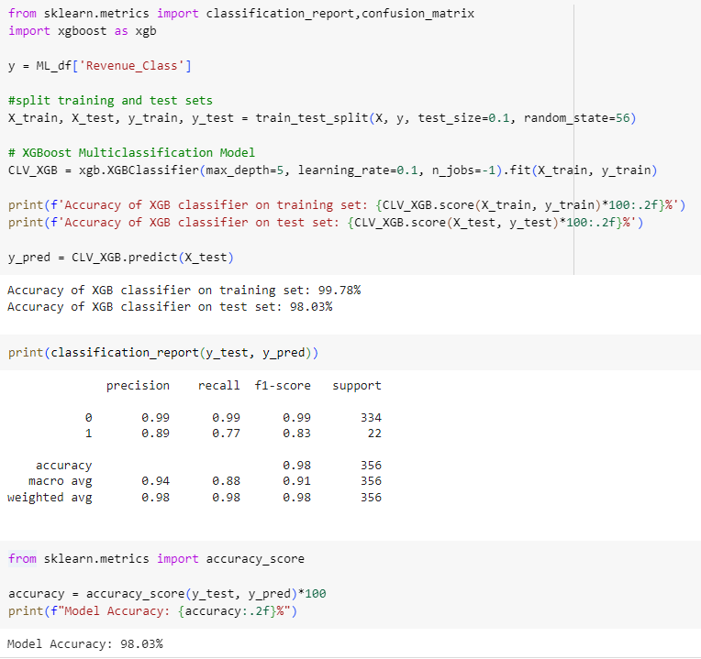
Classification Model

Slide 42
Results
CLV Prediction for 3,554 Customers:
  Linear Deep Learning: RMSE 5.33 (Potentially over fitted)
  XGBoost Regression: RMSE 294.28 (Best balance)
  Historical CLV Benchmark: RMSE 4,406.50 (Simple model)
  BG-NBD Probabilistic: RMSE 4,464.26 (Under fitted or incorrect implementation)
Classification Model: 98% accuracy across classes
Key Insights:
  93% of special offers utilized one specific offer
  Sales increased in years 1-3, dropped in year 4 (only 6 months recorded)
  Top customer by orders (500+) ≠ top customer by revenue ($800,000+)
  Most popular product: 4,000+ orders; Top-selling product: 8,000+ units; Highest revenue-generating product: $4M
Data Processing:
Queried 121,317 records, cleaned and pre-processed data, visualized distributions, and performed modeling and evaluation.

Slide 43

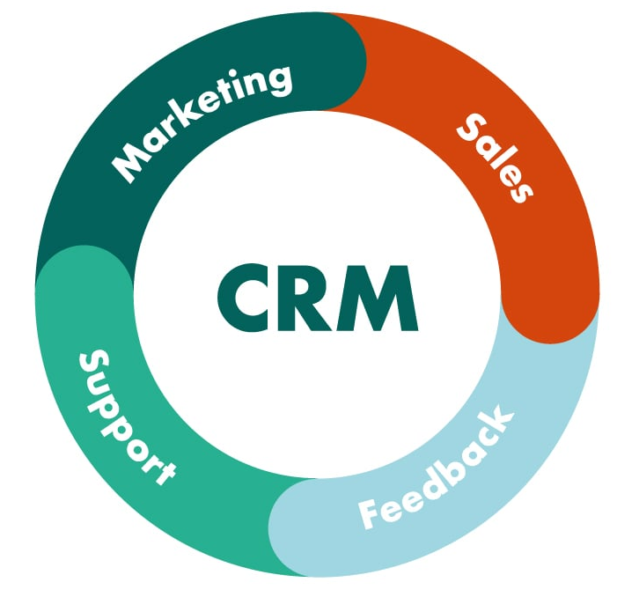
Conclusions and Future Work

Slide 44
References
Scikit-learn Machine Learning in Python documentation: https://scikit-learn.org/stable/
Pandas documentation: https://pandas.pydata.org/docs/
Pandas profiling: https://pypi.org/project/pandas-profiling/
Customer Life Time Value Prediction: https://www.analyticsvidhya.com/blog/2020/10/a-definitive-guide-for-predicting-customer-lifetime-value-clv/

